Slide 1
VIRAL ONCOGENESIS

Slide 2
TERMINOLOGY
Oncology- study of tumors or cancers.
A tumor is an abnormal growth or mass of tissue (also known as lump, lesion, or neoplasm).
Cancer is a group of diseases caused by the uncontrolled growth and spread of abnormal cells.
Tumors can be cancerous BUT not all tumors are cancerous
Tumors can be-
Benign tumor- a growth produced by abnormal cell proliferation that remains localized and does not invade adjacent tissue. Non-cancerous
Malignant tumor- is locally invasive and may also be metastatic, i.e., spread to other parts of the body. Growth that is not encapsulated and infiltrates into surrounding tissues, replacing normal cells Malignant tumors are often referred to as cancers.

Slide 3
Carcinomas- Malignant tumors of epithelial cell origin
Sarcomas- Malignant tumors of cells of mesenchymal origin.
Solid tumors arising from leukocytes are known as lymphomas, or if circulating cells are involved leukemias. Collectively, especially in veterinary medicine, lymphomas and leukemias are known as leukoses.
Oncogenesis- The process through which healthy cells become transformed into cancer cells.
Synonyms tumorigenesis and carcinogenesis.
It is characterized by a series of genetic and cellular changes, including oncogene activation, that lead the cell to divide in an uncontrolled manner.

Slide 4
Cell Transformation
The changes in the biological functions of a cell that result from REGULATION of the cell’s metabolism by viral genes and that confer on the infected cell certain properties characteristic of NEOPLASIA.
Oncogenic virus- has the ability to induce cell transformation and to form tumors.
Transformation by DNA viruses is always nonproductive (i.e., the transformed cells do not yield infectious progeny virus);
Transformation by retroviruses, on the other hand, is usually productive.
Viral (or proviral) DNA in transformed cells is integrated into the cell DNA, except in the case of papillomavirus and herpesvirus DNAs, which remain episomal.

Slide 5
Properties of Transformed Cells
Loss of growth control (loss of contact inhibition in cultured cells)
Cell morphology changes
Altered cell metabolism and membrane changes
Transformed cells frequently exhibit chromosomal aberrations
Capacity to grow in suspension or in semisolid agar (anchorage independence).
Tumor formation when transformed cells injected into suitable animal.
Capacity to produce malignant neoplasms when inoculated into isologous or severely immunosuppressed animals.
Tumor-specific antigens (TSA), found on cancer cells only, not on healthy cells.
Tumor-associated antigens (TAA), which have elevated levels on tumor cells, but are also expressed at lower levels on healthy cells. Self expressed antigens by tumor cells

Slide 6
Discovery
1911: Francis Peyton Rous (1879-1970) demonstrated that a virus (Rous sarcoma virus) can cause cancer in chickens (Nobel Prize, 1966) . He was the first person to show that a virus could cause cancer. It was later called Rous sarcoma virus 1.
1976- J. Michael Bishop and H. Varmus identified the oncogene (v-SRC) carried by Rous sarcoma virus.
Nobel Prize to both in 1989 for this discovery

Slide 7
Mechanisms of Oncogenesis
Activation of cellular proto-oncogenes or cellular oncogenes (c-onc)
Presence of viral oncogene (v-onc)
Inactivation of tumor suppressor genes

Slide 8
Proto-oncogenes
Normal cellular proteins found in all cells, involved in control of cell growth, division, and differentiation.
Highly regulated proteins.
Abbreviated as c-ONCS, eg c-MYC, c-MOS, c-RAS.
Certain retroviruses isolated from tumors carry altered copies of c-ONCS abbreviated as v-ONCS, eg v-MYC, v‐MOS, v-RAS.
Proto-oncogenes are partially or even completely silenced after cellular differentiation is complete.
When they suffer alterations (e.g., amplification, mutations or epigenetic modifications), which are able to completely reactivate them, the proto-oncogenes become oncogenes, and, if overexpressed, they lead to abnormal cell proliferation, dedifferentiation, and immortality, turning them to malignant tumoral cells

Slide 9
Classes of proto-oncogenes
The proteins c-oncogenes encode, called oncoproteins, act in five major ways-
(1) Extracellular growth factors- homologues of normal growth factors
(2) Growth factor receptors- Membrane proteins that capture extracellular signals stimulating cell growth.
(3) Intracellular signal transducers- Transmit signal initiated by growth factor binding to receptors.
(4) Nuclear transcription factors- regulate gene expression
(5) Cell cycle control proteins- negative regulators of cell growth

Slide 10
Activation of Cellular Oncogenes
Abnormal c-onc gene expression may be responsible for some oncogenic transformations.
Insertional mutagenesis- The presence upstream from a c-onc gene of an integrated provirus which lacks the v-onc gene, with its strong promoter and enhancer elements, may amplify the expression of the c-onc gene greatly.
Eg. Integrated avian leukosis provirus increases the synthesis of the normal c-myc oncogene product 30- to 100-fold.
2. Transposition or translocation- Transposition of c-onc genes may result in their enhanced expression by bringing them under the control of strong promoter and enhancer elements.

Slide 11
3. Gene Amplification- The increase in gene copy number leads to a corresponding increase in the amount of oncogene product, thus producing cancer.
Eg. Amplification of c-ras and c-myc genes in human tumors.
4. Mutation- Mutation in a c-onc gene, e.g., c-ras, may alter the function of the corresponding oncoprotein. Such mutations can occur either in situ as a result of chemical or physical mutagenesis or in the course of recombination with integrated retroviral DNA.
Given the high error rate of reverse transcription, v-onc gene homologues of c-onc genes will always carry mutations and the strongly promoted production of the viral oncoprotein will readily exceed that of the normal cellular oncoprotein resulting in uncontrolled cell growth.

Slide 12
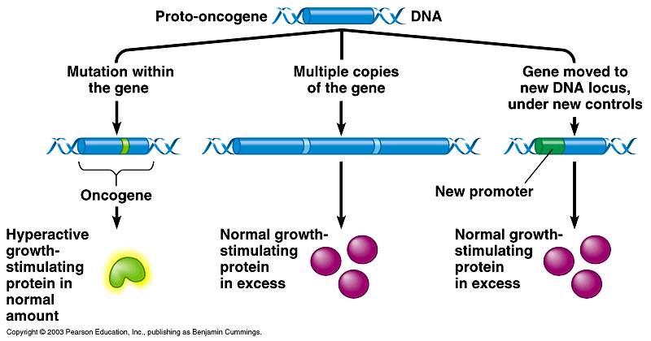
Activation of proto-oncogenes
-mutation
- amplification
- translocation
- insertion of viral genome

Slide 13
Tumor Suppressor Genes and Cell
Cycle Control Proteins
Their protein products are involved in negative regulation of the cell cycle in that they hold the cell at the G1 phase (antioncogenes).
This regulatory role may be ablated by mutations in tumor suppressor genes or by the binding of other oncoproteins to these genes.
Retinoblastoma (Rb) and p53 tumor suppressor proteins each block the progression of the cell cycle at G1.
The p53 protein prevents propagation of genetically damaged cells and also plays a role in triggering apoptosis.

Slide 14
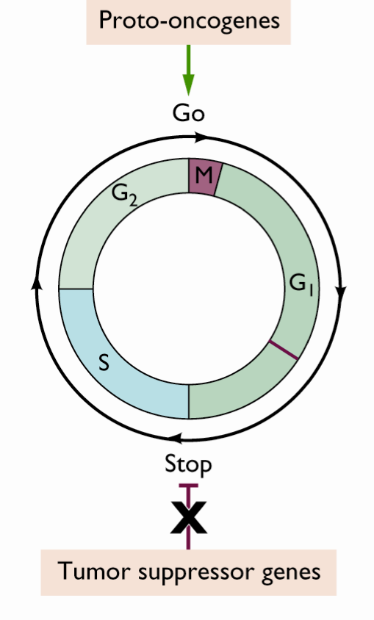
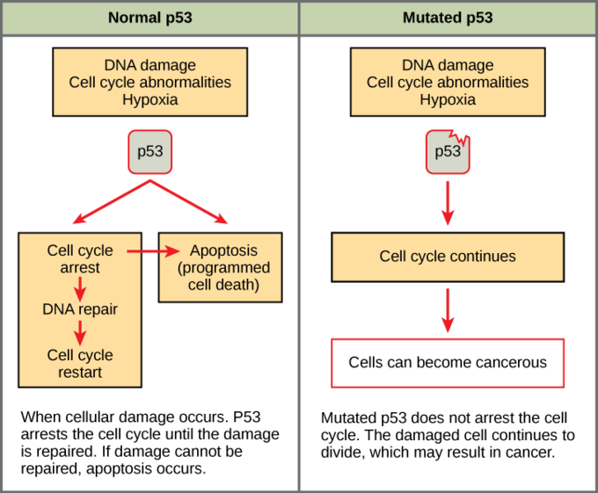

Slide 15
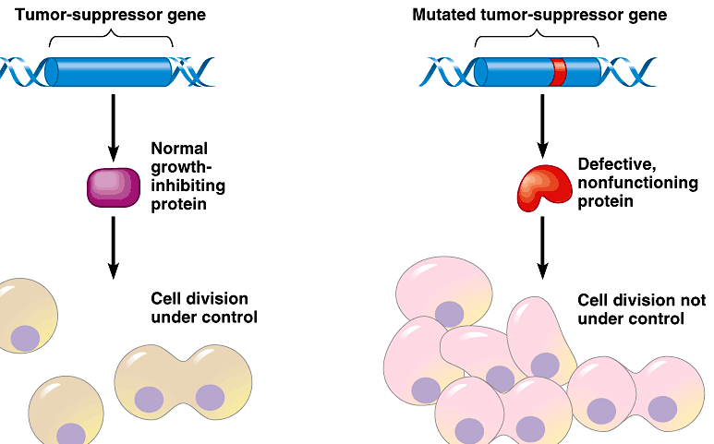
Inactivation of tumor suppressor genes
-mutation
- viral oncoproteins
- viral degradation

Slide 16
v-onc genes
The genes in the viral genome that change host cell proliferation control, lead to the synthesis of new proteins, and are responsible for transformation characteristics are called viral oncogenes (v-onc genes).
Retroviral v-onc genes are not necessary for replication but play role in cellular transformation.
Proto-oncogenes (c-onc genes) are the cellular counterparts of v-onc genes.

Slide 17
v-onc genes
The cellular oncogenes or proto-oncogenes have multiple exons separated by introns, where­as the viral oncogenes are single exons.
v-onc genes are under the control of the viral long terminal repeats ( LTRs ) , which are not only strong promoters but are also influenced by cellular regulatory factors.
v-onc genes may be joined to other viral genes in such a way that their functions are modified.
v-onc genes may undergo mutations (deletions and rearrangements) that alter the structure of their protein products; such changes can interfere with normal protein-protein interactions leading to escape from normal regulation.

Slide 18
Classification of viral oncogenes
1.Growth factors-Growth factors are secreted polypeptides that stimulate the proliferation of target cells and have extracellular signal functions. Target cells must have a specific receptor to be able to respond to a specific type of growth factor.
Eg. The v-sis oncogene and its cellular homolog c-sis encode chain B of platelet-derived growth factor (PDGF). Cells transformed by v-sis produce a platelet-derived growth factor-related molecule which is able to stimulate the platelet-derived growth factor receptor in an autocrine fashion. Incessant expression of the sis gene product (PDGF-β) leads to significant neoplastic transformation in fibroblasts.

Slide 19
2. Growth factor receptors and hormone receptors-
v-erbB oncogene product is a modified epidermal growth factor (EGF) receptor that retains tyrosine kinase activity. In normal cells this kinase becomes activated only after the binding of circulating epidermal growth factor to the receptor.
However, in the presence of the v-erbB gene product, ErbB, the enzyme is activated permanently, phosphorylating any intracytoplasmic protein in its vicinity, thereby initiating a cascade of events culminating in the transmission of conflicting signals to the nucleus. In some cells this results in uncontrolled growth.
The product of the v-erbA gene mimics the intracellular receptor for thyroid hormone. This oncoprotein, ErbA, competes with the natural receptor for the hormone, causing uncontrolled growth.

Slide 20
3. Intracellular Signal Transducers
Mitogenic signals are transmitted from growth factor receptors on the cell surface to the cell nucleus through a series of interconnected complex processes called the signal transduction path.
This regulator information is completed with the gradual phosphorylation of proteins that interact with each other in the cytosol.
The ultimate recipients of the propagated signal are transcription factors that up-regulate specific sets of genes and start a cascade of synthesis that leads to cell growth.
v-onc genes that act as signal transducers are Ha-ras and K-ras
Signal transducers are transformed into oncogenes by mutations that lead to irregular activities, frequently causing uncontrollable cellular proliferation.

Slide 21
4. Transcription factors
Transcription factors are nuclear proteins which regulate the expression of target genes or gene families.
Transcriptional regulation is induced by the binding of protein to specific DNA sequences or DNA structural motifs that are located above the target genes.
Transcription factors are the final step of the signal transducer process that changes extracellular signals into modulated changes in gene expression.
Many c-onc genes are transcription factors and they were discovered by studies on retroviruses that have homology with proto-oncogenes. Some examples of these factors are erb A, ets, fos, jun, myb, and c-myc.

Slide 22
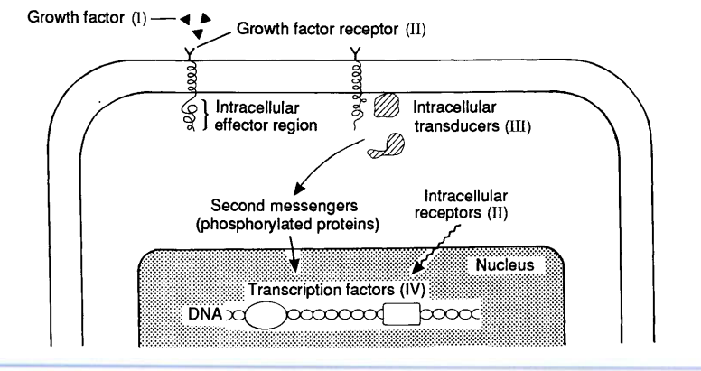

Slide 23
Tumor induction by retroviruses
Replication competent
Replication defective
Endogenous retroviruses
Exogenous Retroviruses (rapidly transforming or trans-activating and slowly transforming or cis- activating viruses)
Retroviral oncogenes have very recently been derived from the host, most likely from the species from which the virus was isolated.

Slide 24
Replication-Competent and Replication-
Defective Retroviruses
The genome of a typical replication-competent slowly transforming retrovirus consists of two identical copies of a positive sense, single-stranded RNA molecule, each of which has three genes:
gag, encoding core proteins
pol, encoding the reverse transcriptase, integrase, RNase H,
pro –protease gene
Env, encoding envelope glycoproteins.

Slide 25
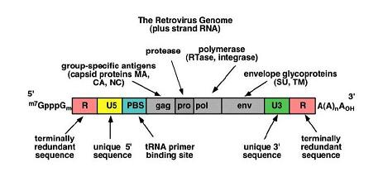

Slide 26
It has a cap at the 5′ end and a poly(A) tail at the 3′ end.
The RNA genome has terminal non-coding regions, which are important in replication, and internal regions that encode virion proteins for gene expression.
The 5′ end includes four regions, which are R, U5, PBS, and L.
The R region is a short repeated sequence at each end of the genome during the reverse transcription in order to ensure correct end-to-end transfer in growing chain.
U5 is a short unique sequence between R and PBS.
PBS (primer binding site) consists of 18 bases complementary to 3′ end of the tRNA primer, which supplies an ‘OH group to initiate reverse transcription.
The L region is an un-translated leader region that give the signal for packaging of genomic RNA.

Slide 27
The 3′ end includes 3 regions, which are PPT (polypurine tract), U3, and R.
PPT (or PP), polypurine tract is the primer for plus-strand DNA synthesis during reverse transcription.
U3 is a sequence between PPT and R, which has signal that provirus can use in transcription.
R is the terminal repeated sequence at 3′ end, the same as the R (i.e., repeat region) of the 5′ end.
Replication defective retrovirus- v-onc gene is usually incorporated into the viral RNA in place of part of one or more normal viral genes.
These viruses are usually defective, i.e., they are dependent on non defective helper retroviruses for their replication.
They are rapidly transforming retrovirus.

Slide 28
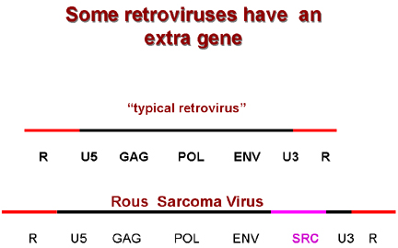
Rous sarcoma virus is replication competent and rapidly oncogenic

Slide 29
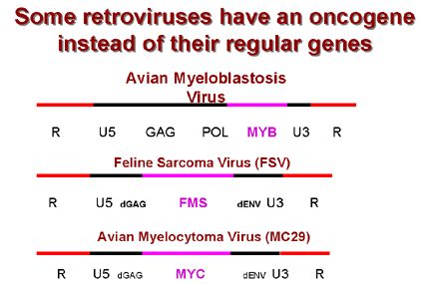

Slide 30
In the integrated form, the provirus is more complicated.
Part of the 3' unique region (called U3) of the RNA genome has been copied and transposed to the opposite end of the genome.
Conversely, part of the 5' end of the unique region (called U5) has been copied and transposed to the other end.
The U3-R-U5 regions are known as long terminal repeats or LTRs.
The U3 region contains all of the promotor information that is necessary to start RNA transcription at the beginning of the R (repeat) region while the U5 region contains all of the information necessary to terminate after the other R repeat.

Slide 31
In addition, the LTRs contain information that enhances the degree of transcription of the three retroviral genes (enhancer regions).
These enhancers can be up or downstream from the protein-encoding part of the genes.
The expression of mRNA from the provirus is under the control of the viral transcriptional regulatory sequences, which include promoter and enhancer elements that are located in the long terminal repeats.

Slide 32
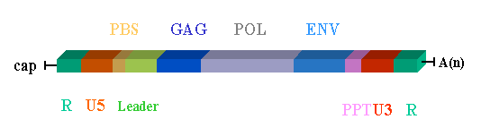
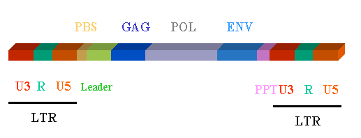
The structure of the RNA genome of the mature retrovirus
The genome structure of the DNA proviral form of a retrovirus

Slide 33
Endogenous and exogenous Retroviruses
A complete DNA copy of the genome (known as the provirus) of one, or sometimes more than one, retrovirus may be transmitted in the germ line DNA from parent to progeny (i.e., via ova or sperm) and may thus be perpetuated in every cell of every individual of certain vertebrate species.
Such proviral genomes are under the control of cellular regulatory genes and are normally completely silent in normal animals. Such retroviruses are said to be endogenous.
Expression of such proviruses can be induced by various factors such as irradiation and exposure to mutagenic or carcinogenic chemicals or hormonal or immunological stimuli, so that virions may be produced in some circumstances with some viruses

Slide 34
Exogenous retroviruses behave as more typical infectious agents, spreading horizontally to contacts.
Most endogenous retroviruses never produce disease, cannot transform cultured cells, and contain no oncogene in their genome.
Most exogenous retroviruses, however, are oncogenic; some characteristically induce leukemias or lymphomas, others sarcomas, and yet others carcinomas, usually displaying a predilection for a particular target cell.

Slide 35
Exogenous retroviruses
Rapidly oncogenic or transducing
Slowly oncogenic or cis-activating
Carry v-onc gene
No v-onc gene
Rous sarcoma virus
Avian leukosis virus

Slide 36
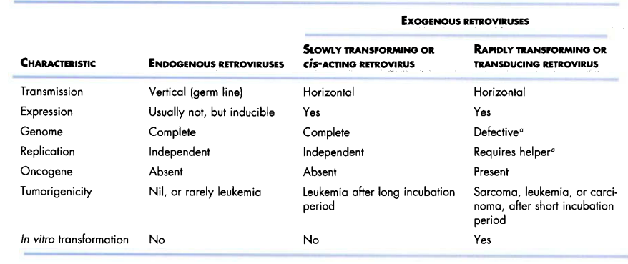

Slide 37
Mechanisms of Tumor Induction by Retroviruses
Transducing retroviruses introduce a v-onc gene into the chromosome of the cell. Are replication defective transform cells rapidly both in vitro and in vivo.
cis-activating retroviruses, which lack a v-onc gene, transform cells by becoming integrated in the host cell DNA close to a c-onc gene and thus usurping normal cellular regulation of this gene. Are replication competent, induce tumors more slowly, and do not transform cells in culture,
trans-activating retroviruses contain a gene that codes for a regulatory protein that may either increase transcription from the viral long terminal repeat or interfere with the transcriptional control of specific cellular genes. Either have no oncogenic activity or induce tumors very late by affecting cellular transcription

Slide 38
Tumor Induction by DNA Viruses
DNA tumor viruses interact with cells in one of two ways:
(1) productive infection, in which the virus completes its replication cycle, resulting in cell lysis, or
(2) non-productive infection, in which the virus transforms the cell without completing its replication cycle. During such non-productive infection, the viral genome or a truncated version of it is integrated into the cellular DNA or, alternatively, the complete genome persists as an autonomously replicating plasmid (episome). The genome continues to express early gene functions.
Eg polyoma viruses, papilloma viruses, Herpes virus, Hepadna viruses, and adenoviruses

Slide 39
DNA virus oncogenes act primarily in the nucleus, where they alter patterns of gene expression and regulation of cell growth.
In every case the relevant genes encode early proteins having a dual role in viral replication and cell transformation.
With a few possible exceptions, the oncogenes of DNA viruses have no homologue or direct ancestors (c-onc genes) among cellular genes of the host.
The protein products of DNA virus oncogenes are multifunctional, with particular functions that mimic functions of normal cellular proteins.

